Slide 1
Orders and Drugs
A programmer's guide

Slide 2

What is an order?
It's a request made by a user (usually a provider) on behalf of a patient
Intended to be processed by another system or component within OpenMRS

Slide 3
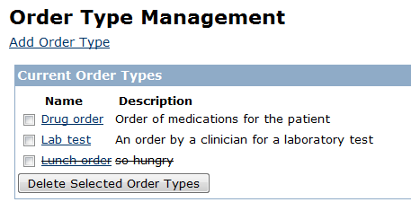
Order types
OpenMRS allows us define our own types of orders
Two types are built-in:
Lab test - this is a request by a clinician for a specific laboratory test for a patient
Drug order - this is a request by a provider for a specific drug for a patient
Administration > Manage Order Types

Slide 4
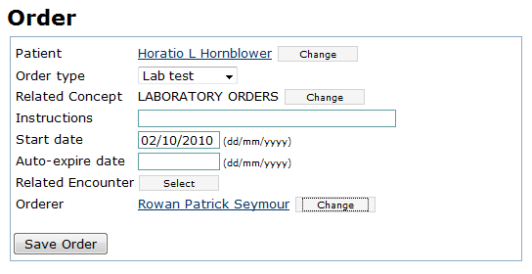

Lab test orders
A clinician can order a lab test
A separate laboratory module or system should then allow lab technicians to see ordered tests and submit their results
Lab test
order
Results
(observations)

Slide 5
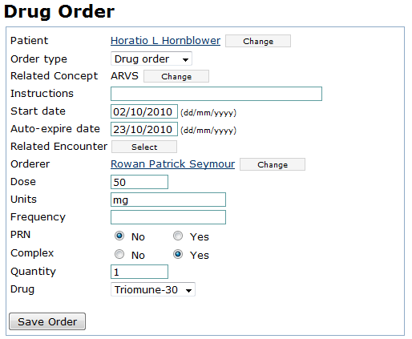

Drug orders
A provider can create this to order drugs for a patient
A separate pharmacy module or system should then allow a pharmacist to process that order
Drug
order

Slide 6
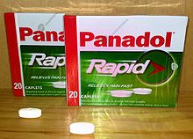
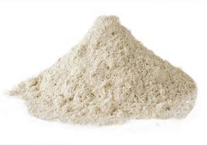
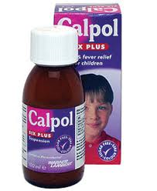
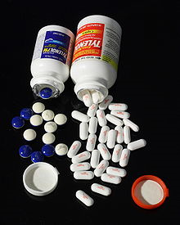
Drugs
Different branded drugs may have the same active ingredient, e.g.
Paracetamol - Panadol, Tylenol, Calpol, etc
Paracetamol

Slide 7
Drugs in OpenMRS
The active ingredient or generic drug is stored as a Concept in OpenMRS
Each different brand is then stored as a different Drug entry
Drug
Paracetamol
Concept
Drug
Drug

Slide 8
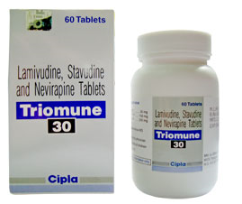
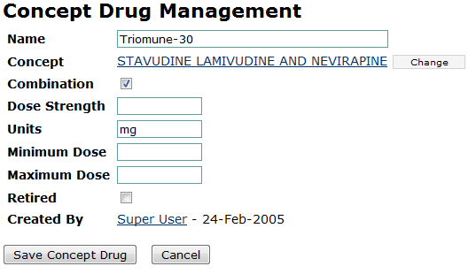
Example: Triomune-30
The brand (DRUG)
The active ingredients (CONCEPT)
Important information about the drug

Slide 9
Drug orders
Thus a drug order contains a drug, which contains a concept...
DrugOrder
DrugOrder
Drug
TRIOMUNE-30
Concept
STAVUDINE LAMIVUDINE AND NEVIRAPINE

Slide 10
Classes: Order
This is used to hold orders of type "Lab test"
Is the base class of DrugOrder...
class Order {
private Patient patient;
private OrderType orderType;
private Concept concept;
private String instructions;
private Date startDate;
private Date autoExpireDate;
private Encounter encounter;
private User orderer;
private Boolean discontinued;
private User discontinuedBy;
private Date discontinuedDate;
private Concept discontinuedReason;
private String accessionNumber;
...
}

Slide 11
Classes: DrugOrder
This is used to hold orders of type "Drug order"
class DrugOrder extends Order {
private Double dose;
private Double equivalentDailyDose;
private String units;
private String frequency;
private Boolean prn;
private Boolean complex;
private Integer quantity;
private Drug drug;
...
}

Slide 12
Finding drugs
Drugs are accessed via the concept service
By drug name...
By concept...
Drug drug =
Context.getConceptService().getDrug("Triomune-30");
Concept id for STAVUDINE LAMIVUDINE AND NEVIRAPINE
Concept cpt =
Context.getConceptService().getConcept(792);
List<Drug> drugs =
Context.getConceptService().getDrugsByConcept(cpt);

Slide 13
Creating a drug order...
DrugOrder drugOrder = new DrugOrder();
drugOrder.setOrderType(drugOrderType);
drugOrder.setPatient(patient);
drugOrder.setStartDate(startDate);
drugOrder.setAutoExpireDate(stopDate);
drugOrder.setConcept(concept);
drugOrder.setDrug(drug);
drugOrder.setDose(dosage);
drugOrder.setFrequency(frequency)
drugOrder.setUnits(units);
General order properties
Drug order properties

Slide 14
Order service examples
To create a new order, use...
To get all the orders for a specific patient, use...
Order order = new Order();
...
Context.getOrderService().saveOrder(order);
Patient patient = ...
List<Order> orders = Context.getOrderService().
getOrdersByPatient(patient);

Slide 15

Regimens
Drugs are often prescribed to a patient in a regimen of multiple drugs
Unfortunately OpenMRS core doesn't currently have a way to model such a regimen
But...

Slide 16

Regimen module
Works by examining the start and end dates of a patient drug orders
Drug orders starting and ending simultaneously are consider part of the same regimen
Usable by other modules as a library

